Slide 1
Equality handling and efficiency improvement of SMT for non-linear constraints over reals.
Vu Xuan Tung – Ogawa lab - JAIST

Slide 2
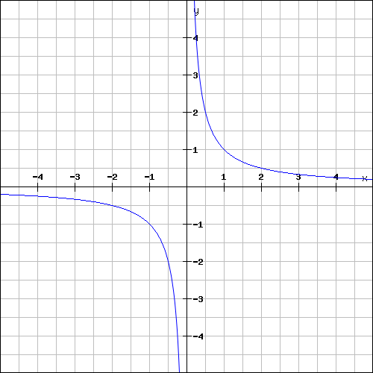
Non-linear (polynomial) constraints over reals
If there exist an assignment of x, y that satisfies the constraints → satisfiable (SAT).
Otherwise, unsatisfiable (UNSAT)

Slide 3
Polynomial constraints over reals
Polynomial constraints solving has applications in:
Automatic termination proving.
Roundoff error and overflow error analysis.
Invariant generation.

Slide 4
Polynomial constraints over reals
In 1930, Tarski: polynomial constraints is decidable
Methods:
QE-CAD: complete but DEXP complexity.
Interval constraint propagation: ISAT uses interval arithmetic (IA) only, ability of solving SAT problem is limited.
Bit-blasting: (UCLID, MiniSmt) suffers with high number of variables or high degree of polynomials.
Linearization: suffers with high degree of polynomials (Barcelogic, CORD).
Virtual substitution: Z3, SMT-RAT. Needs root formulas of polynomial
➔ degree <= 5
raSAT: IA + testing

Slide 5
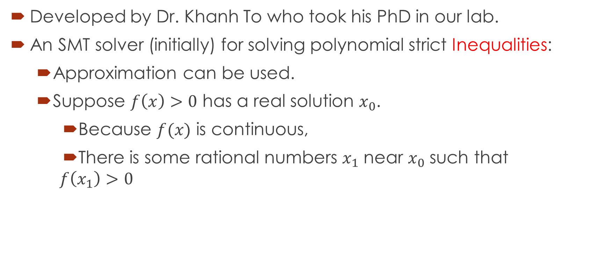
raSAT
Developed by Dr. Khanh To who took his PhD in our lab.
An SMT solver (initially) for solving polynomial strict Inequalities:
Approximation can be used.
Suppose $f\left(x\right)>0$ has a real solution $x_{0}$.
Because $f(x)$ is continuous,
There is some rational numbers $x_{1}$ near $x_{0}$ such that
$$f\left(x_{1}\right)>0$$

Slide 6
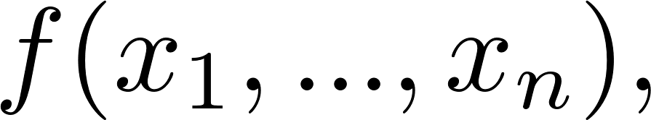
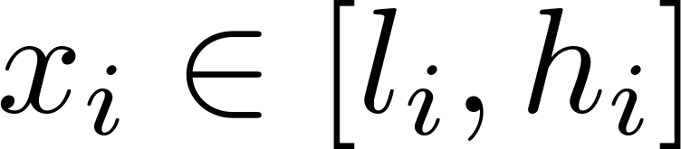
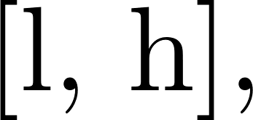

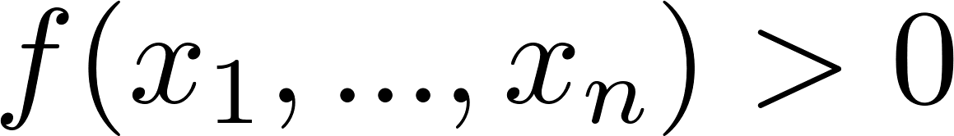



Over approximation - Interval arithmetic (IA)
Interval arithmetic
l
h
IA-UNSAT
UNSAT
l
h
0
IA-VALID
SAT
0
l
h
IA-UNKNOWN
UNKNOWN
l
0
h

Slide 7
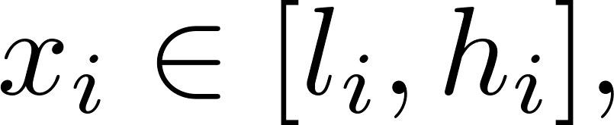
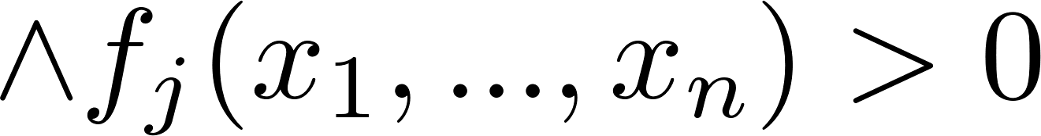
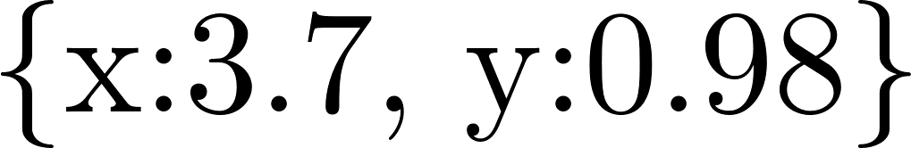
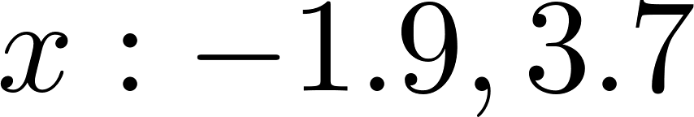
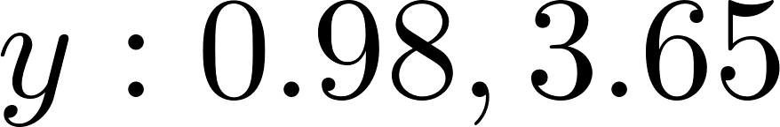
Under approximation - Testing
Testing:
Randomly generate values for variables
SAT with variables assignment
UNKNOWN
Example:
Testing:
Randomly generate values for variables
SAT with

Slide 8
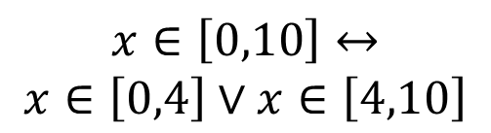

$$Constraints$$
raSAT
Yest
Threshold - Unknown
NO
SAT solver
UNSAT/
Unknown
Learn conflicts
Theory solver
Refined clauses
YES
IA-UNSAT
Interval Arithmetic
US Core
$$x∈\left[0,10\right]↔$$
$$x∈\left[0,4\right]∨x∈\left[4,10\right]$$
Refinement
IA-UNKNOWN
IA-VALID
Test-UNSAT
Testing
TEST-SAT
SAT

Slide 9
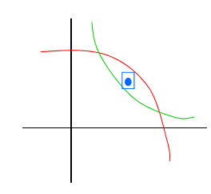
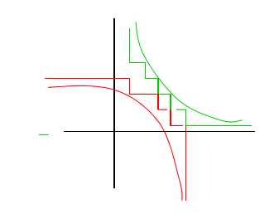
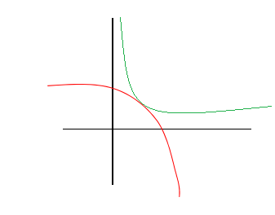
Completeness (strict inequality)
raSAT eventually detects SAT
UNSAT detected
UNSAT failed

Slide 10
raSAT
In this work:
Improve the efficiency of raSAT.
Handle equality.
Handle polynomial constraints over Integer (QF_NIA).

Slide 11
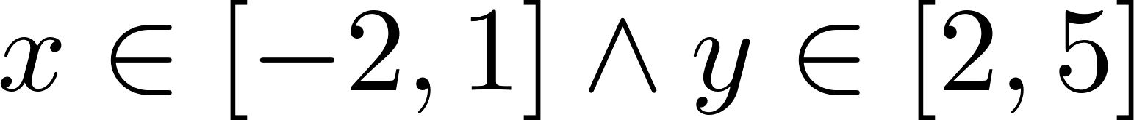
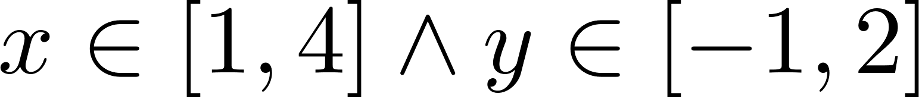
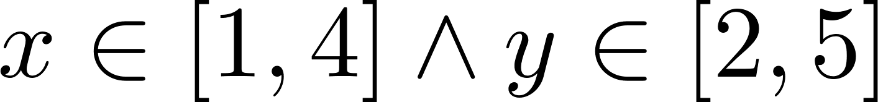
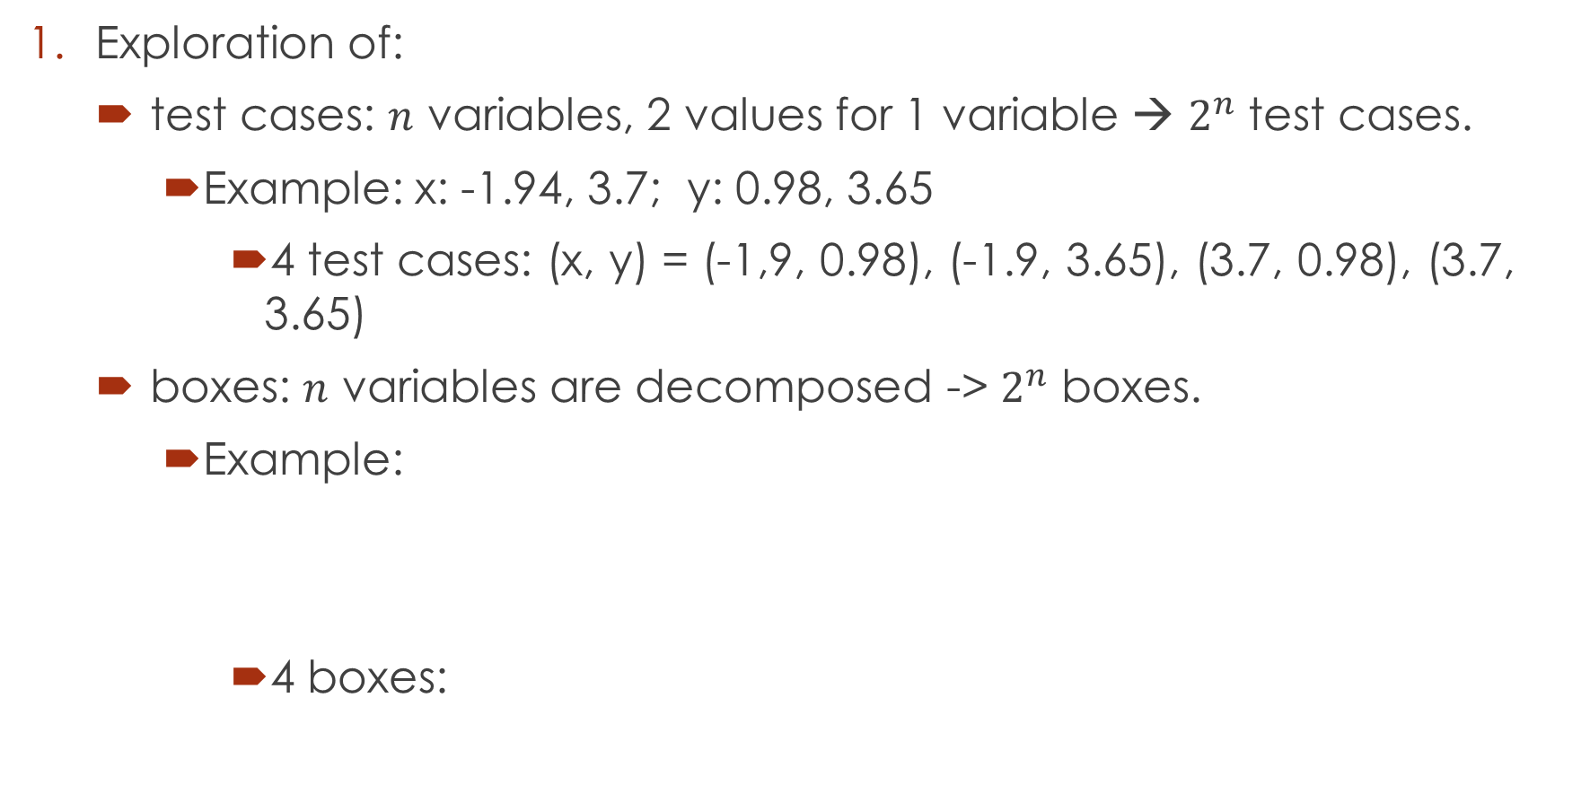
Problems
Exploration of:
test cases: $n$ variables, 2 values for 1 variable → $2^{n}$ test cases.
Example: x: -1.94, 3.7; y: 0.98, 3.65
4 test cases: (x, y) = (-1,9, 0.98), (-1.9, 3.65), (3.7, 0.98), (3.7, 3.65)
boxes: $n$ variables are decomposed -> $2^{n}$ boxes.
Example:
4 boxes:

Slide 12
Problems.
Soundness.
Floating point arithmetic: round-off, overflow errors.
Equality handling.
Using the intermediate value theorem.

Slide 13
Current status

Slide 14
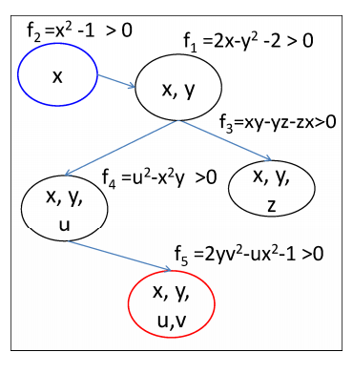

1. Exploration of test cases
n variables → $2^{n}$ test cases.
Priority on variables:
Choice of constraint: Dependency
Choice of variables in one constraints: Sensitivity
E.g. with $x=1+ε_{1}$, $y=2+ε_{2}$
$xy=2ε_{1}+ε_{2}+ε_{1}ε_{2}+2$: x is more sensible than y.

Slide 15
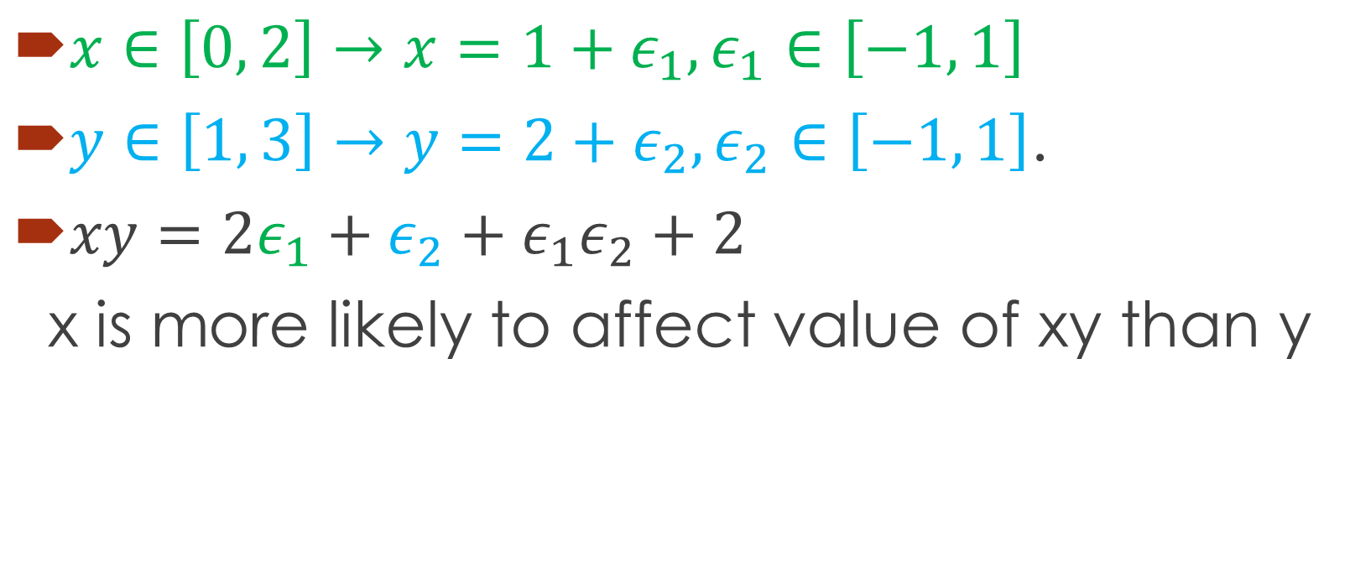
Sensitivity by AI
$x∈\left[0, 2\right]→x=1+ε_{1},ε_{1}∈\left[−1, 1\right]$
$y∈\left[1, 3\right]→y=2+ε_{2}, ε_{2}∈\left[−1, 1\right]$.
$xy=2ε_{1}+ε_{2}+ε_{1}ε_{2}+2$
x is more likely to affect value of xy than y

Slide 16
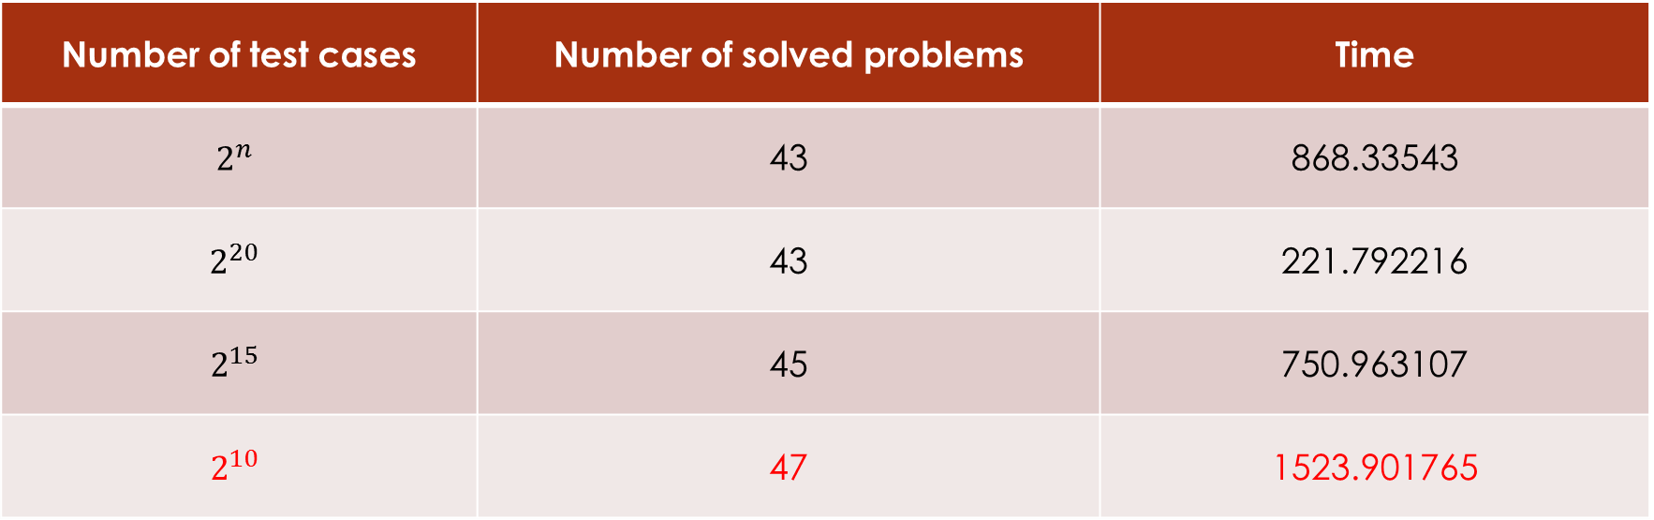
1. Testing phase - Experiments
Zankl family contains 166 problems extracted from automatic termination proving of term rewriting systems.
Number of test cases | Number of solved problems | Time
$$2^{n}$$ | 43 | 868.33543
$$2^{20}$$ | 43 | 221.792216
$$2^{15}$$ | 45 | 750.963107
$$2^{10}$$ | 47 | 1523.901765

Slide 17
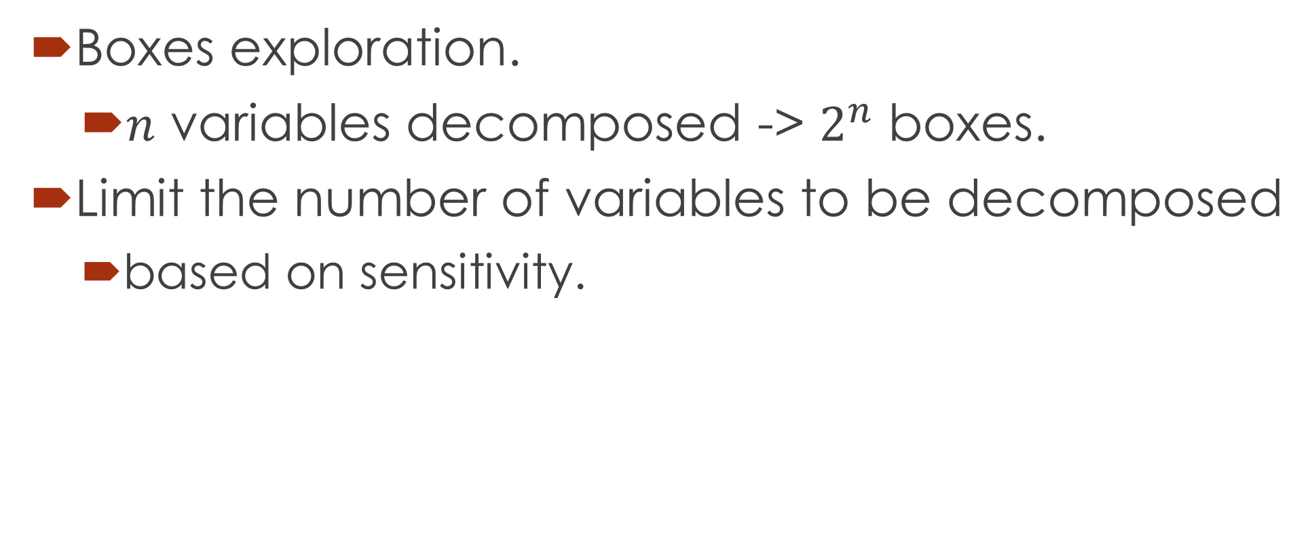
2. Decomposition
Boxes exploration.
$n$ variables decomposed -> $2^{n}$ boxes.
Limit the number of variables to be decomposed
based on sensitivity.

Slide 18
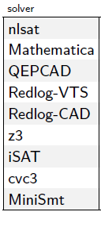
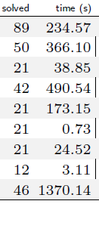
2. Decomposition - Experiments
Time out = 500s, no threshold for intervals
Time out = 900s
Number of vars decomposed. | Number of solved problems. | Time
all | 47 | 1523.901765
5 | 47 | 458.867299
4 | 46 | 436.340371
3 | 45 | 787.156501
2 | 47 | 2215.54318
1 | 50 | 1695.125339
Dejan Jovanovic, Leonardo Mendonça de Moura: Solving Non-linear Arithmetic. IJCAR 2012: 339-354

Slide 19
3. SAT, UNSAT verification
Round-off, overflow errors can make the result unsound.
iRRAM:
C++ package
Error-bounded real arithmetic
Integrated iRRAM into raSAT for SAT verification.
Future work: Verify UNSAT results
Improve UNSAT core.

Slide 20
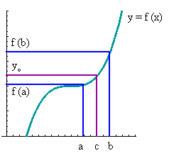
5. Equality handling.
Intermediate value theorem
=f(c)

Slide 21
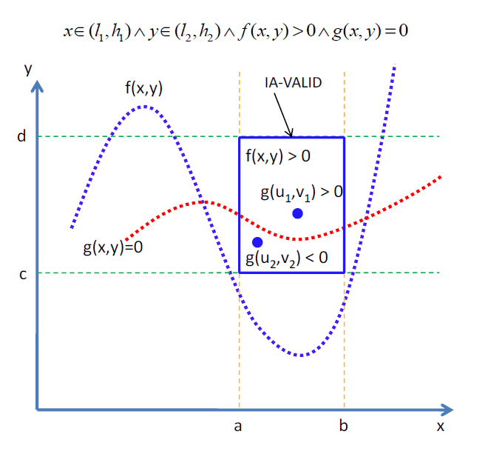
5. Equality handling.
Intermediate value
theorem
Single equality:
Done in previous work.

Slide 22
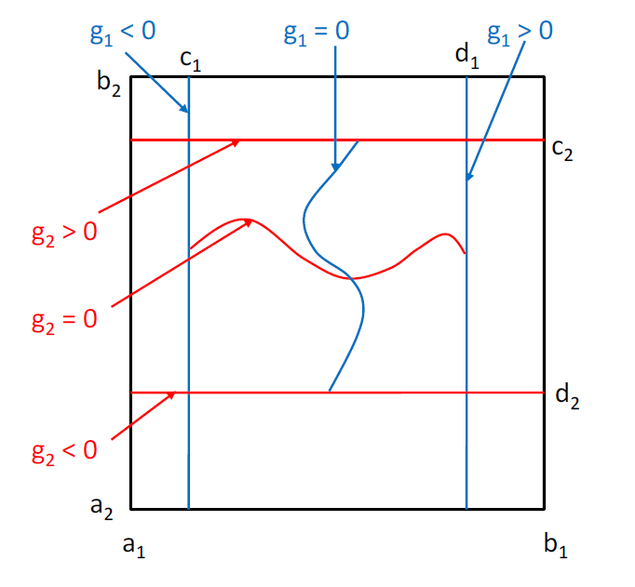

5. Equality handling.
Intermediate value
theorem
Multiple equalities:
Number of variables
$≥$ number of equations
To be done.

Slide 23
6. Extend for QF_NIA
Current approaches:
Bit blasting: suffers with high degree of polynomials.
Linearization:
Bit-blast one operand of a multiplication.
Can be solved by raSAT:
IA to remove UNSAT intervals.
Generate integer test cases.
Future work

Slide 24
Thank you for your attention

Slide 25
Doctor course Proposal

Slide 26
Problems.
Equality extension: Grobner basis.
UNSAT proof generation

Slide 27
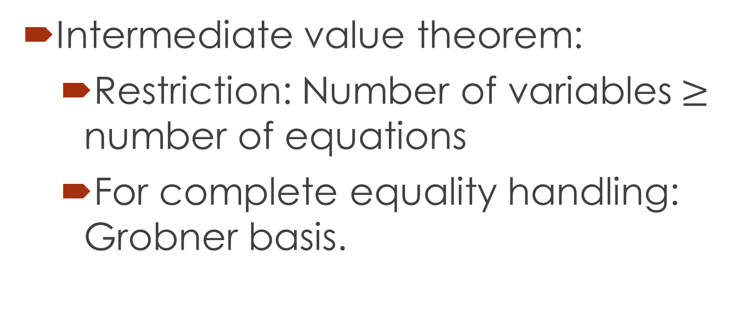
1. Equality extension: Grobner basis.
Intermediate value theorem:
Restriction: Number of variables$≥$ number of equations
For complete equality handling: Grobner basis.

Slide 28
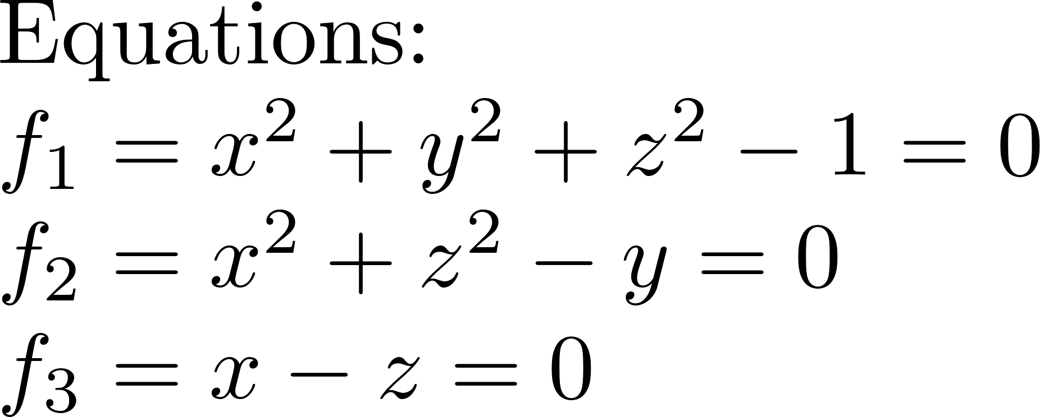

1. Equality extension: Grobner basis.

Slide 29
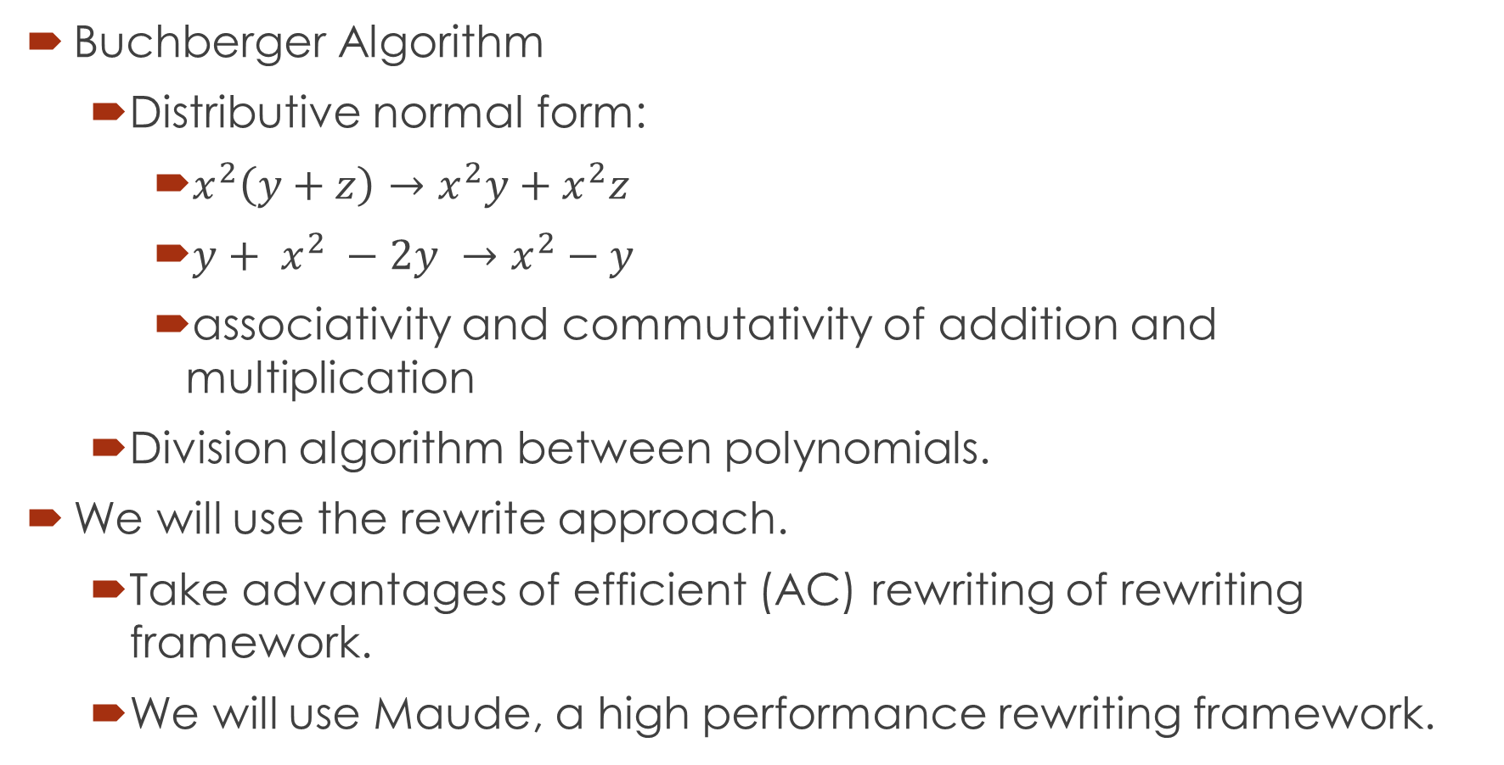
1. Equality extension: Grobner basis.
Buchberger Algorithm
Distributive normal form:
$x^{2}\left(y+z\right)→x^{2}y+x^{2}z$
${y+ x}^{2} −2y →x^{2}−y$
associativity and commutativity of addition and multiplication
Division algorithm between polynomials.
We will use the rewrite approach.
Take advantages of efficient (AC) rewriting of rewriting framework.
We will use Maude, a high performance rewriting framework.

Slide 30
1. Equality extension: Grobner basis.
Maximal completion:
Gradually extend the equations set.
For each step:
Generate terminating TRSs that uses maximal number of equations in the set.
Check if there exist a complete system for the original equations set.
Yes: Return the complete system
No: Add un-joinable pairs to the equations set.
MaxComp?

Slide 31
2. UNSAT proof generation
Proof of UNSAT can be used to extract Craig interpolants.
Craig interpolants have applications in:
Abstraction refinement.
Invariant generation.
Most of the current works focus on Linear Arithmetic.
Not much research on interpolants of polynomial constraints.
Such interpolants arise during verification of complex systems such as hybrid ones.

Slide 32
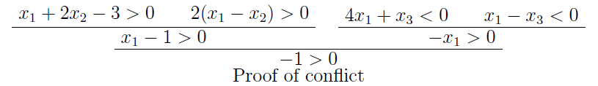
Related works
MATHSAT supports interpolation over Linear arithmetic.
Theory solver generates proofs for conflict clauses.
SAT solver generates resolution proof of unsatisfiability.
Resolution rule:
Interpolants are extracted from the above proofs.
CSIsat also support interpolants of LA constraints.

Slide 33
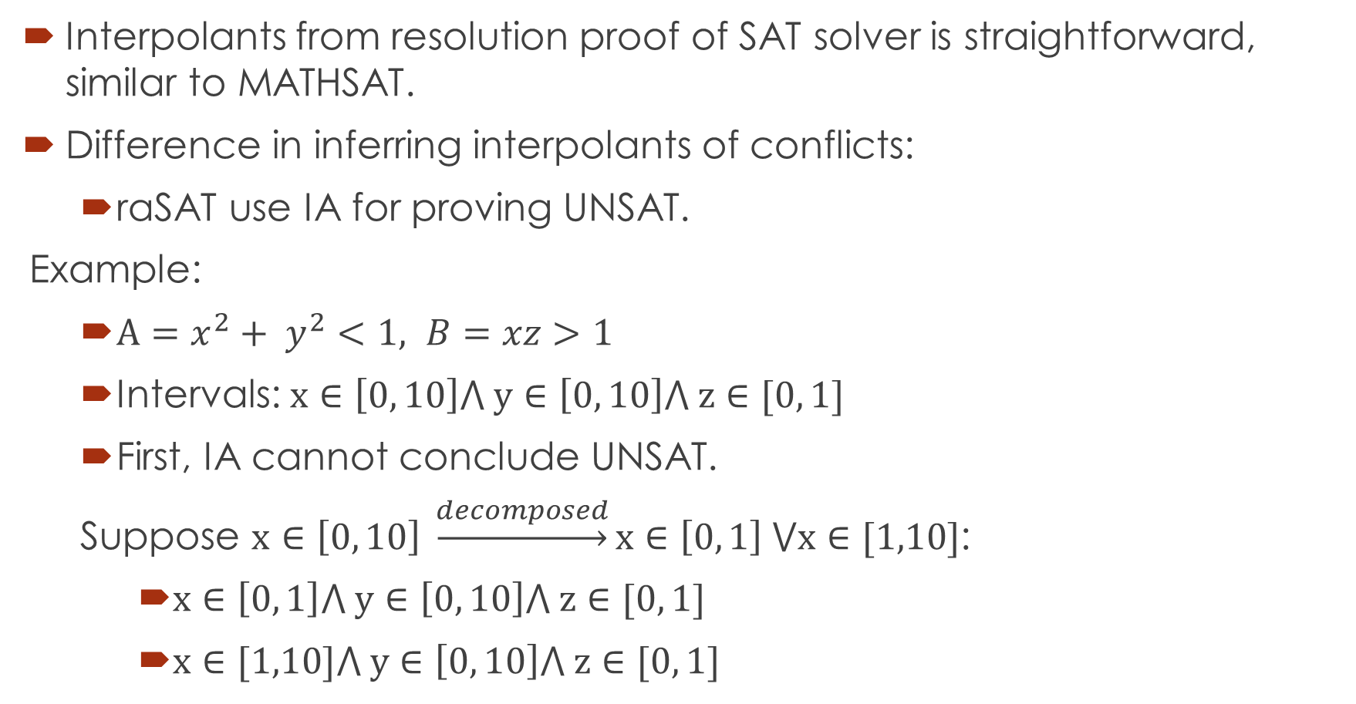
Primary idea
Interpolants from resolution proof of SAT solver is straightforward, similar to MATHSAT.
Difference in inferring interpolants of conflicts:
raSAT use IA for proving UNSAT.
Example:
$A=x^{2}+ y^{2}<1, B=xz>1$
Intervals: $x∈\left[0, 10\right]⋀ y∈\left[0, 10\right]⋀ z∈[0, 1]$
First, IA cannot conclude UNSAT.
Suppose $x∈\left[0, 10\right] \underset{→}{decomposed}x∈\left[0, 1\right] ⋁x∈[1,10]$:
$x∈\left[0, 1\right]⋀ y∈\left[0, 10\right]⋀ z∈[0, 1]$
$x∈[1,10]⋀ y∈\left[0, 10\right]⋀ z∈[0, 1]$

Slide 34
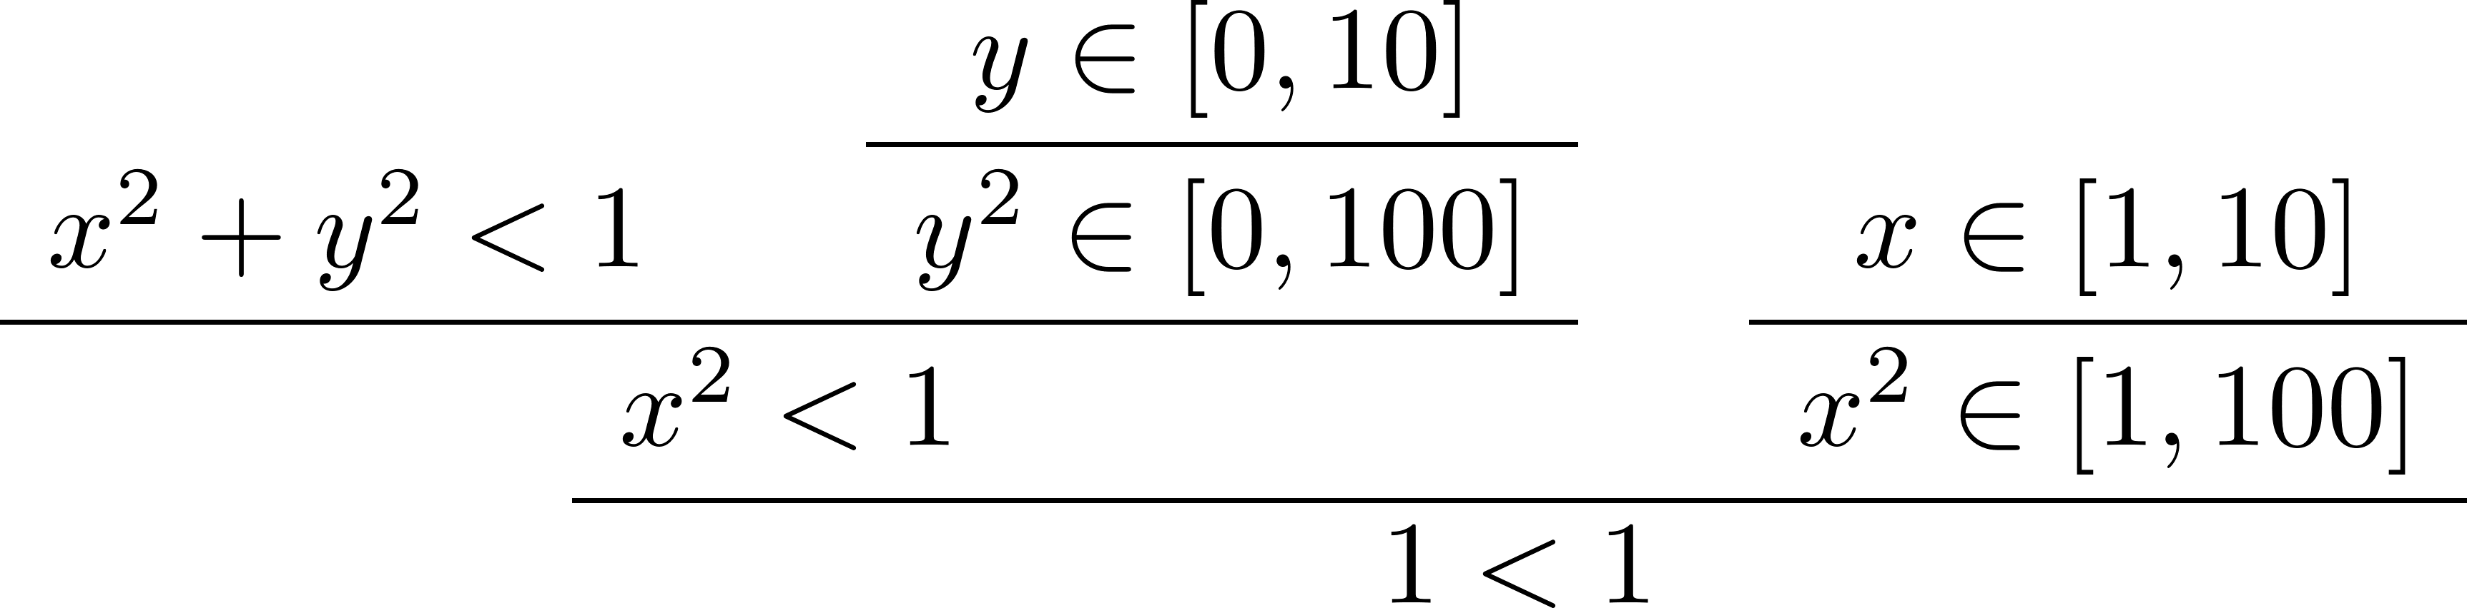
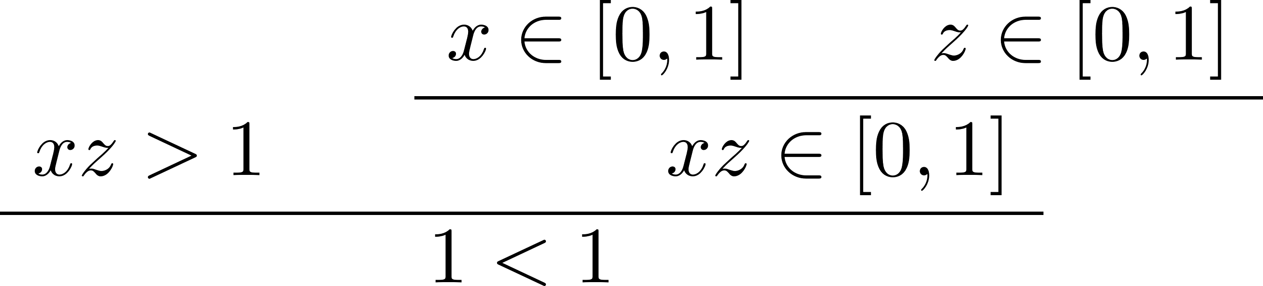

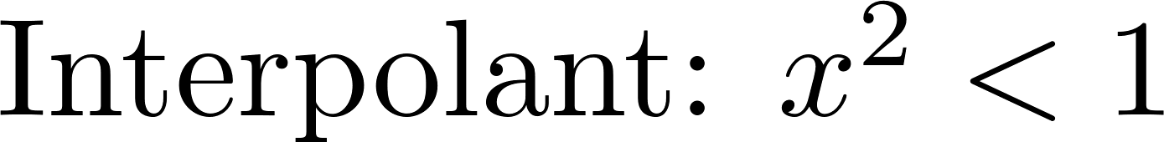


$$A=x^{2}+ y^{2}<1, B=xz>1$$
From resolution proof, we can infer as final interpolant

Slide 35
Thank you for your attention

